Slide 1
Airline Customer Satisfaction Prediction
A Binary Classification Problem

Slide 2
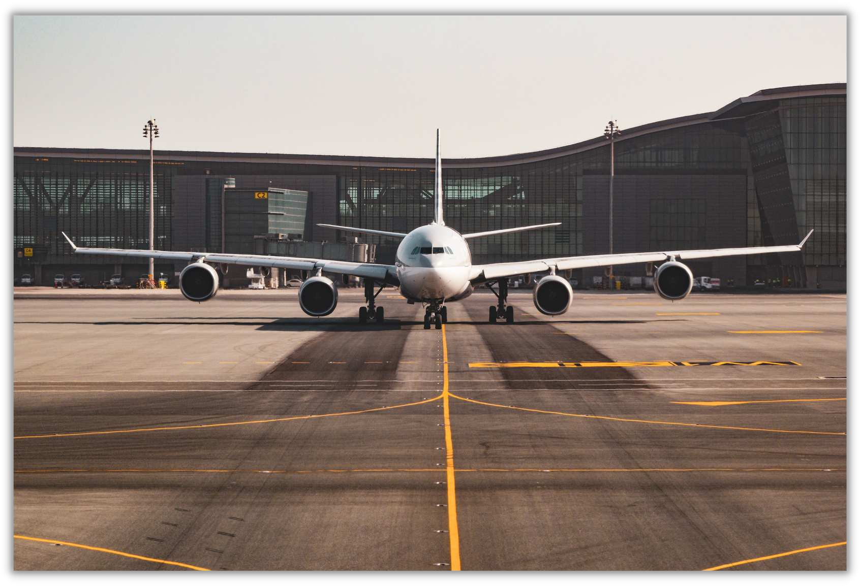
Flight Crew
DATA ANALYSTS
Dreama Wang - 261112206 Nishi Nishi - 261078870
DATA SCIENTISTS
Riley Zhu - 261094733 ShanShan Lao - 261072808
BUSINESS ANALYSTS
Micheal Murphy - 261060598 Vibhu Bhardwaj - 261113187
PRODUCT MANAGERS:
Darin Zlatarev - 261081234 Utkarsh Nagpal - 261071466

Slide 3
1.4 Billion
CUSTOMER SATISFACTION
NET PROMOTER SCORE PROGRAMS
200,000
USD Per Year
Amount spent on running NPS programs for a company with 1000 employees and
$100 million in revneue
USD Per Year
Revenue each US airline leaves on table by failing to improve their customer experience
Source: Forrester
Source: CustomerGauge

Slide 4
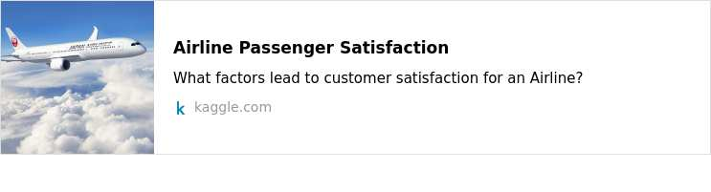
Destination
Objective:
Predict Customer Satisfaction
Identify features that contribute most to customer satisfaction
Use semi-supervised learning to create labels for data
Outcome:
Increased Revenue (upto USD 1.4B)
Cost savings in running NPS programs
Improved brand image and perception
Dataset:
Balanced Classification Dataset
Binary labels in target column named "satisfaction"
Source: Kaggle
https://www.kaggle.com/datasets/teejmahal20/airline-passenger-satisfaction? select=train.csv

Slide 5
Flight Path
04
Semi-Supervised Learning
05
Results & Interpretation
01
EDA
02
Preprocess
03
Supervised Learning
Descriptive statistics, data exploration, correlation tests etc.
Null values impute, Outlier removal, test train validation split etc.
log reg, tree, boosting models on labelled dataset
log reg, tree, boosting models on unlabelled dataset
Results comparison, insight generation etc.
Performance Measure - F1 score Test/Train/Validation Split - 10/80/10% Assumptions - No data leakage

Slide 6
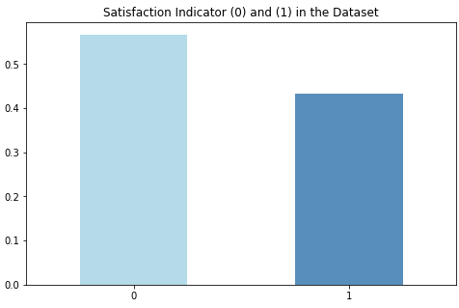
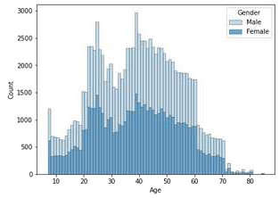
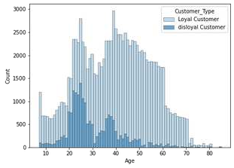
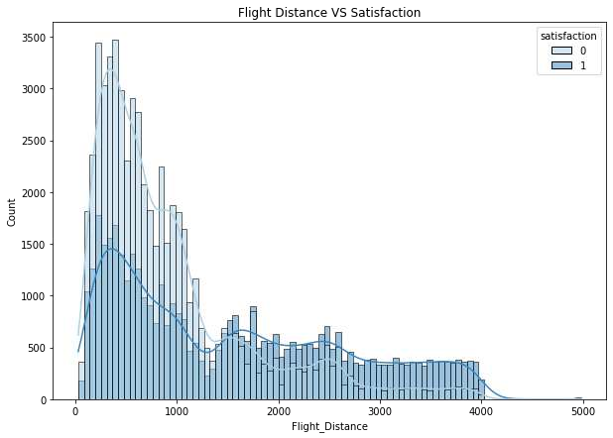
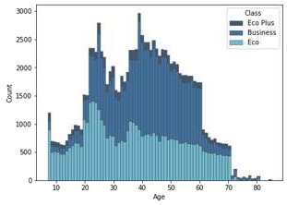
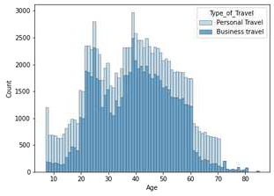
EDA Results
Dataset Overview
Data Preparation
Target Column - satisfaction (satisfied: 1, neutral or dissatisfied: 0)
Passengers' ratings for flight services such as check-in, in-flight wifi, food & drinks, and seat comfort.
Passengers' attributes such as age, gender, loyal/disloyal customer, business/personal travel.
Treating categorical variables Ordinal encoding for travel class
One-Hot Encoding - gender, customer type, type of travel
Removed outliers using Isolation Forest
Treated missing age values using SimpleImputer with median strategy
EDA - Visualizations
Distribution of Target Variable
Relationship among categorical variables
Flight Distance vs Satisfaction

Slide 7
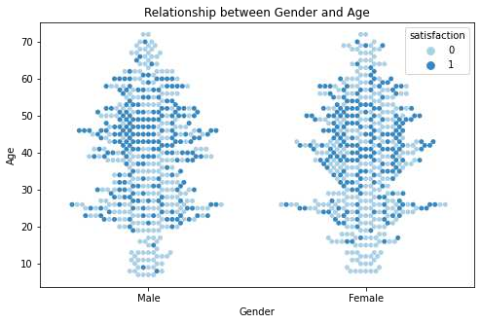
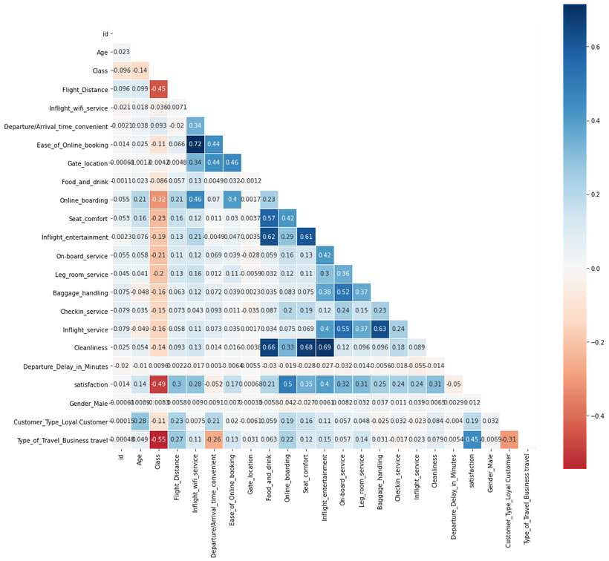
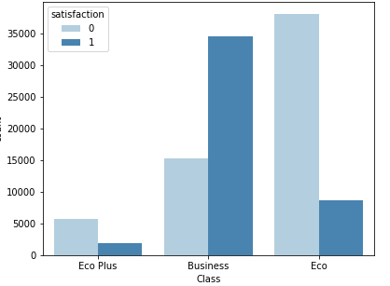
Data Insights
Correlation Matrix
Average satisfaction can vary based on age and gender
Females are on average less satisfied than males with flying
Idem for the oldest age group compared to others
Females had an average satisfaction rate of 42.74% compared to 45.95% for males. Individuals aged between 40 and 60 years old are most satisfied.
Idem for flying class and purpose of travel.
Passenger satisfaction rates significantly increase when compared with the class they are flying in.
One possible factor is that for business travel, flights are often subsidized by the company who chooses business class (hence the name) and thus passengers are more satisfied as they are essentially flying for free.
Negative correlation between distance and class Cleanliness being positively correlated with food, inflight entertainment and seat comfort
Idem for inflight handling and baggage service
Loyal customers being more likely to travel for business and upgrade their class
Users who book online are more likely to use in flight Wi-fi and be dissatisfied by it
Business Class travelers were satisfied 69.45% of the time.
Passengers who flew for business similarly had a 58.26% satisfaction rate.

Slide 8
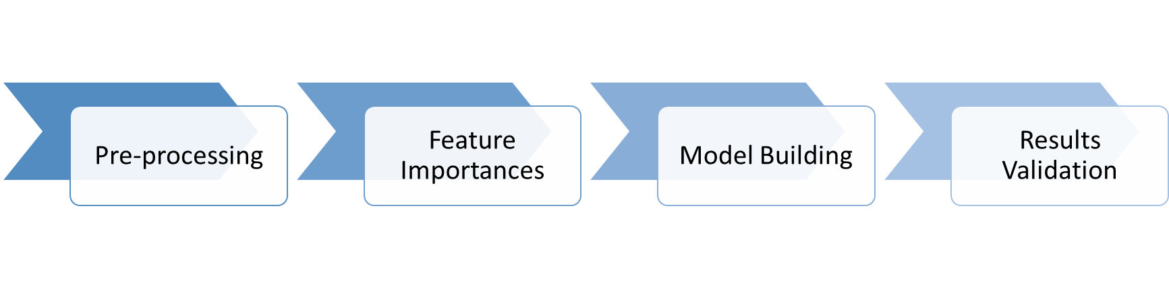
Modelling Approach
Scaling - Standard Scaler
Missing Value Imputation - Custom Function Test Train Validation Split - 10/80/10% split
Label Propagation KNN
Label Spreading KNN
Logistic Regression Random Forest Light GBM XGBoost AdaBoost Naive Bayes
ROC curve, PR curve Classification score
Confusion Matrix Precision, Recall, F1 Score
Recursive Feature Elimination (RFE) Lasso Regression

Slide 9
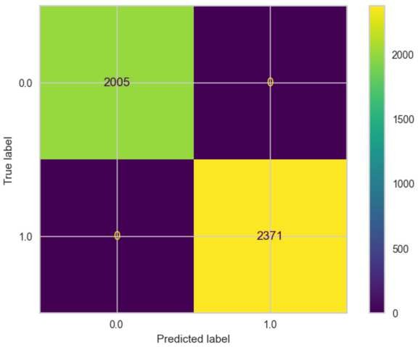
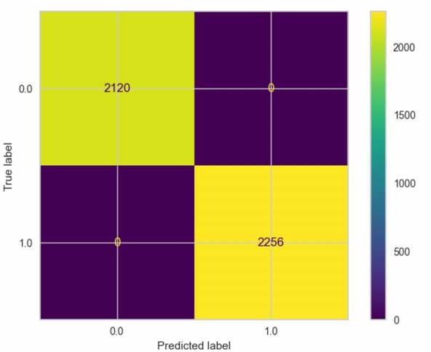
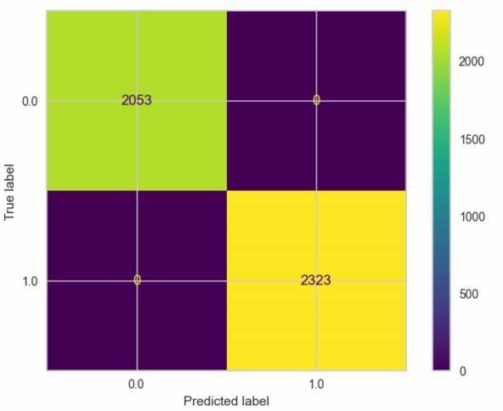
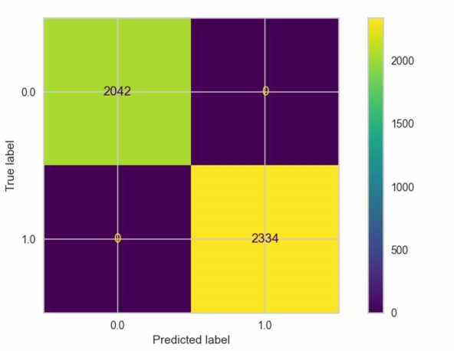
Results
Logistic Regression
Naive Bayes
Precision : 93.71%
Recall: 94.41%
Precision : 94.01%
Recall: 90.44%
Random Forest
Light GBM
Precision : 98.14%
Recall: 97.22%
Precision : 98.11%
Recall: 97.65%

Slide 10
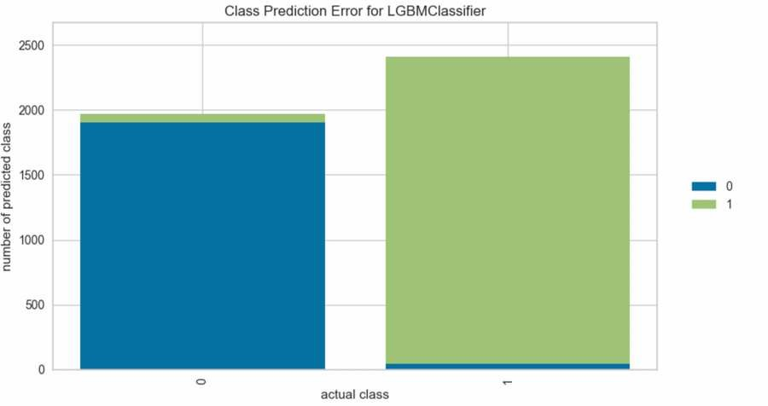
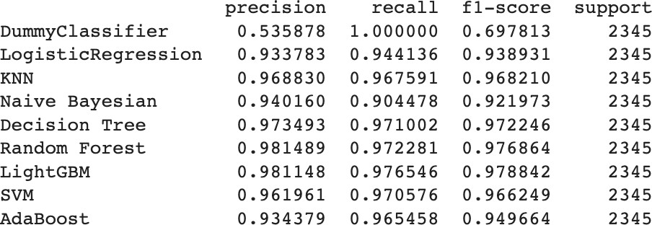
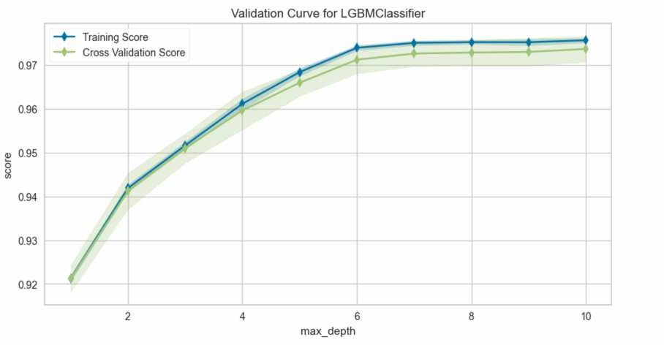
Best Model - Supervised Learning
Results - LightGBM
LiofthtGBM also performs really well on the test set
Based on the F1 score, LiofthtGBM is the best model

Slide 11
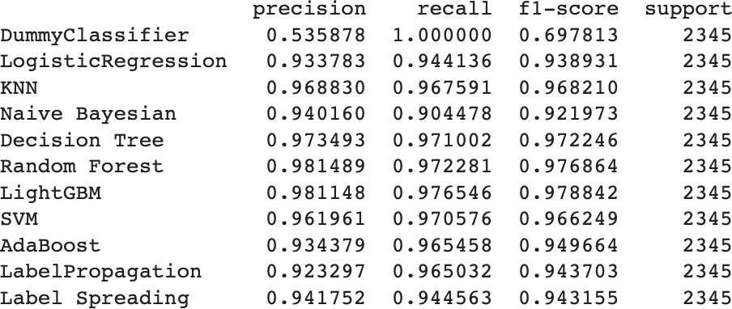
Supervised vs Semi-Supervised Learning
Semi-supervised Learning
Supervised Learning
Label Propogation is the best semi- supervised technique
LightGBM is the best supervised technique

Slide 12
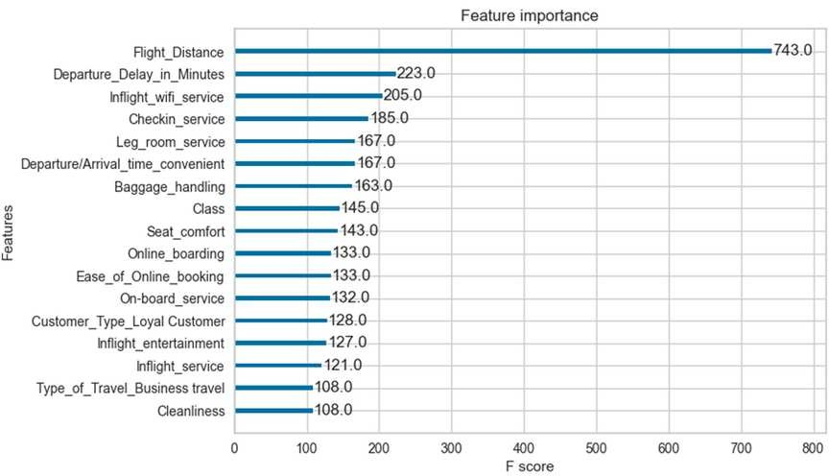
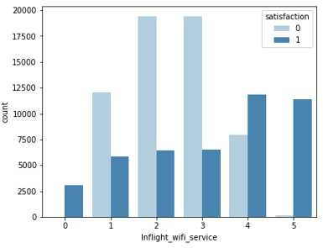
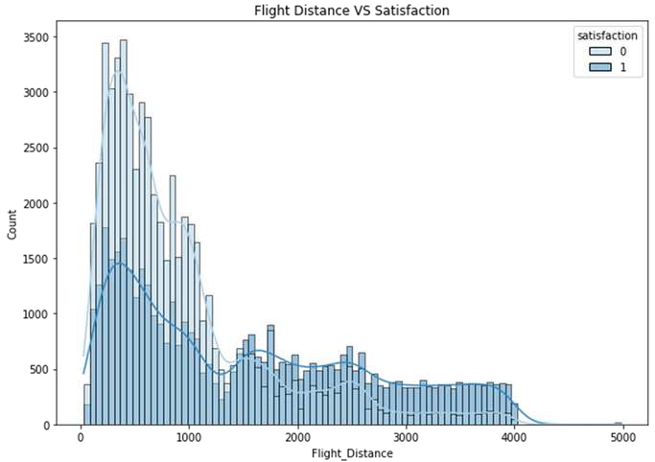
Final Insights
Feature Importance
We observe the feature importance of the most accurate model (LightGBM) and conclude that Flight_Distance, Departure_Delay_in_Minutes and Inflight_wifi_service are among the most important features to accurately predict the customer satisfaction.
In-Flight Wifi Service
Flight Distance
Lower distance flights are where the most focus on increasing satisfaction should be made as these are where the most complaints are being generated.
The customer satisfaction is increasing and dissatisfaction is decreasing as the WIFI service rating increase.

Slide 13
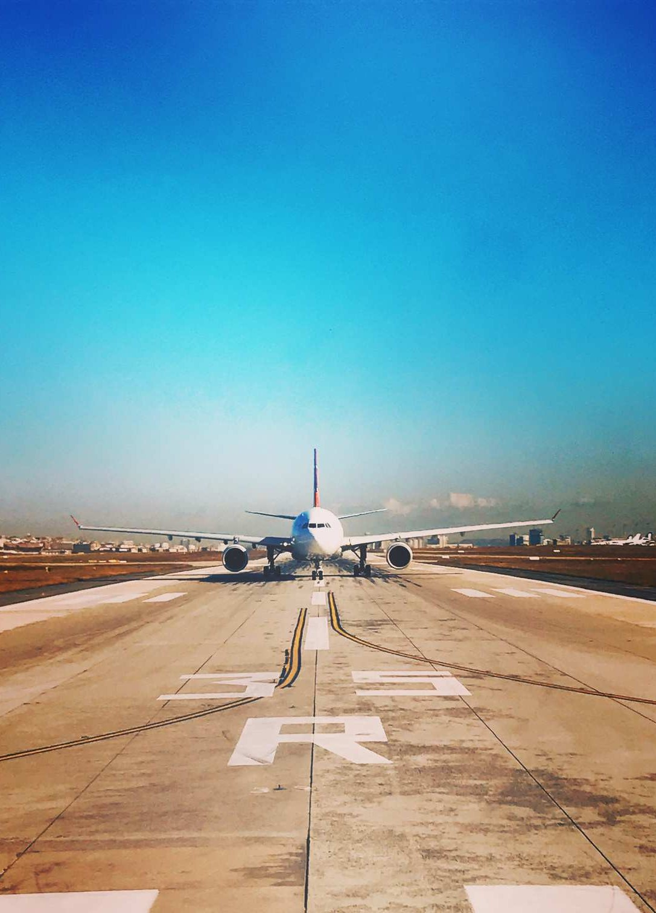
Landing
Quick Win - Provide better inflight WIFI
Semi-supervised learning can save cost of expensive NPS programs Focus on operational efficiency increasing satisfaction on short distance flights

